Slide 1
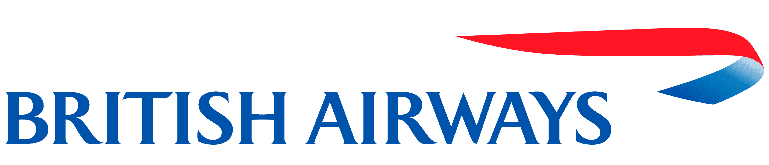
Reviews Analysis

Slide 2
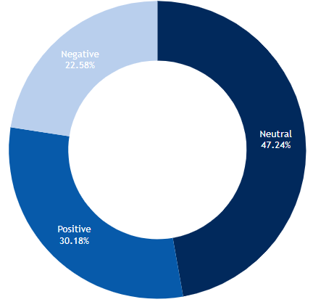
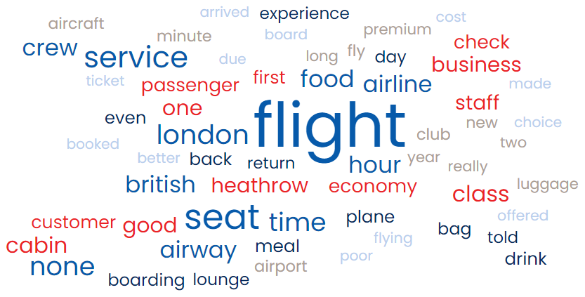
Out of 3,787 reviews on Skytrax,
1,789 are Neutral,
1,143 are Positive, and
855 are Negative
Top 10 words that appear in the reviews are Flight, Seat, Service, London, Time, Food, Crew, Hour, Class, and Cabin
Key Take Aways
More than 77% of the reviews are Neutral-Positive
7/10 words are related to in-flight activities
To improve customer satisfaction, in-flight services can be a focus such as overall flight experience, seating, general service, food served, crew training and behavior, class and cabin situations.

